Slide 1
Upper Limb Muscle Dynamics
Hungtang Ko, Visak C.V. Kumar

Slide 2
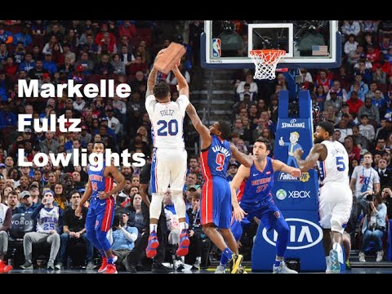
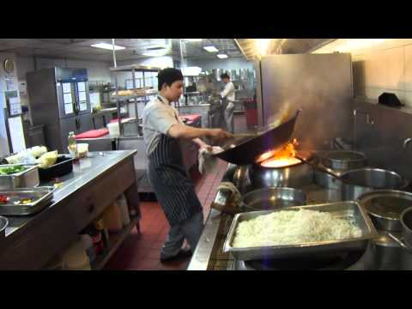
Need for Upper Limb Model
Project goal: Map joint motion to activity levels of muscles involved, in the hope to guide the exoskeleton design.

Slide 3
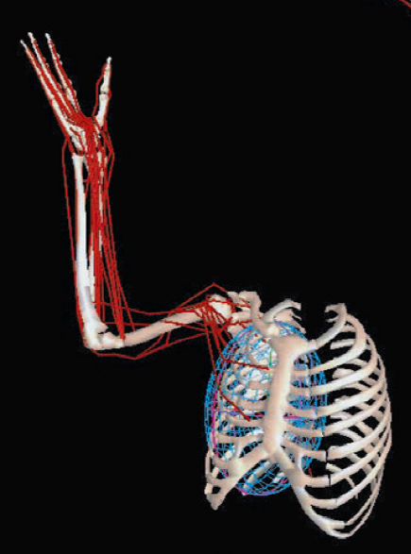
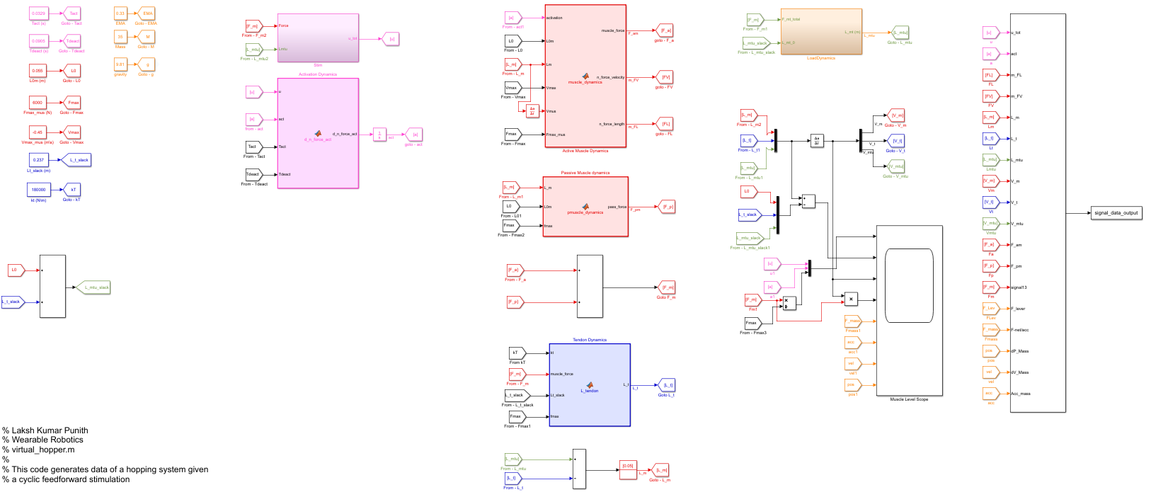
Transition from Simulink model
Code blocks and functions
Environment block:
MTU Force
Output:
MTU acceleration
MTU block:
Activation level
MTU Kinematics
Output:
MTU Force

Slide 4
Python Model Outline
Class MTU Function MTU(Act, Lmtu, Lm_old, Lt_old) Return Fmtu, Lm, Lt
Environment Block Function MomentArm(Joint Angles) Return Moment arms Function TwoLinkDynamics(Angles, Torques) Return Joint Accelerations
Funtion MuscleLength(Joint Angles) Return Lmtu
Muscles Shoulder: Deltoid Anterior & Deltoid Posterior Elbow: Bicep & Tricep
Bones Upper Arm: Humerus Lower Arm: Ulna & Radius
Parameter Settings Fmax, Lm0, Lt0 from Song(2008) Vmax from rescalling with Lm0 Tendon stiffness same as Hopper Model Bone mass moment of Inertia from Song(2008)
Integration

Slide 5
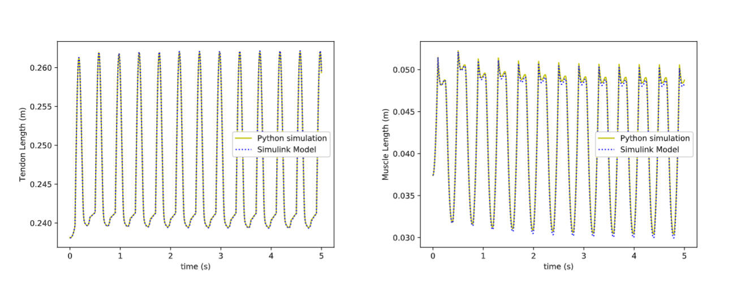
Validation against Hopper Model in Simulink

Slide 6
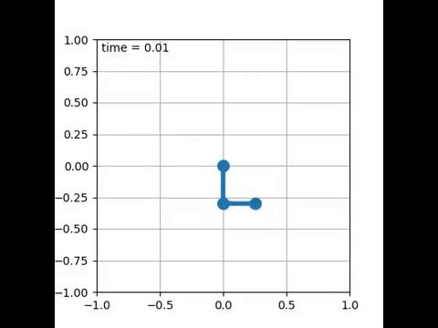
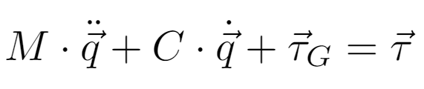

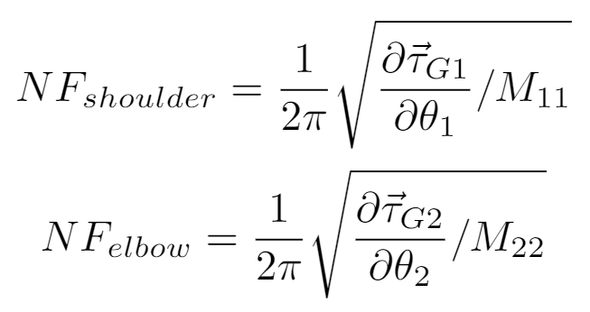
Physics of Two-Linkage System
Dynamic Equation
Natural Frequency

Slide 7
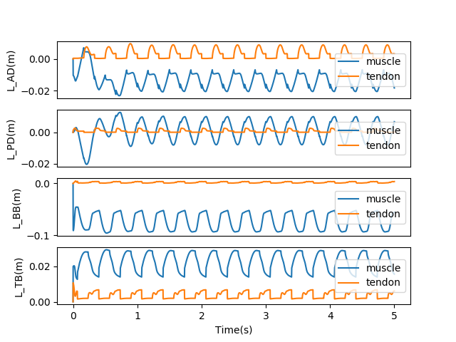

Free Movement Example - Counterclockwise Motion

Slide 8
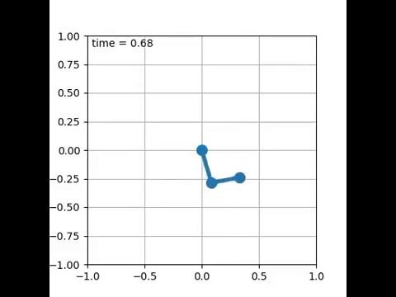
Free Movement Example - Clockwise Motion

Slide 9
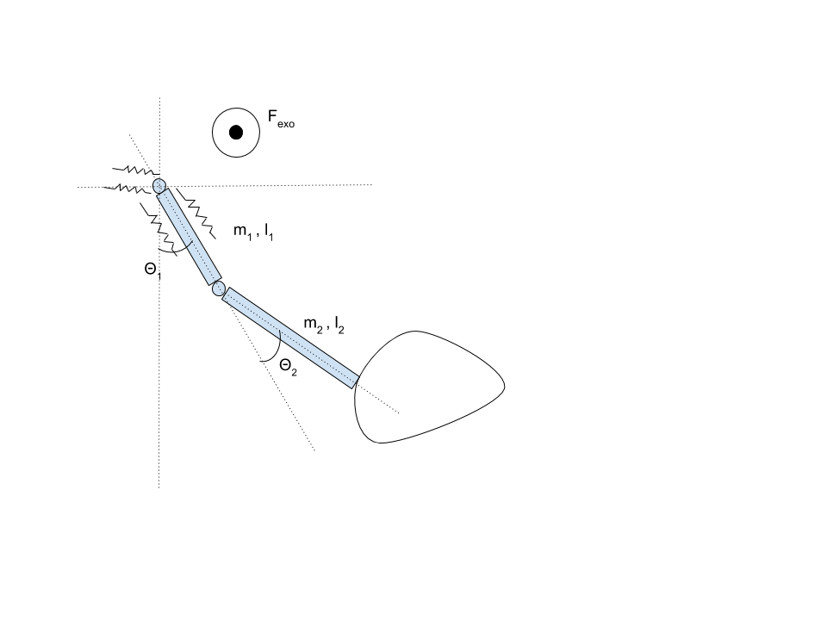







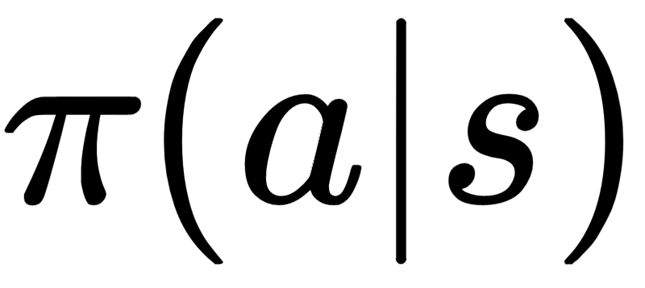
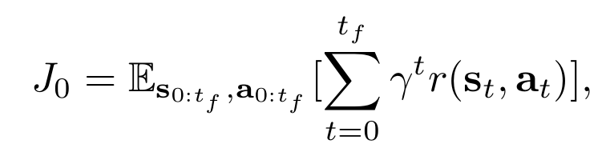

Reinforcement learning - Problem set up
MDP :
State : Action : Termination :
Initial State Distribution :
Transition probability :
Solution :
Reward :
Algorithm : Proximal Policy Optimization

Slide 10
Learnt Control Policies :
With Exo
Without Exo

Slide 11
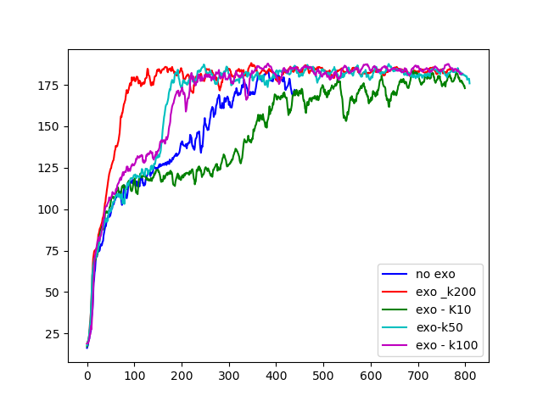
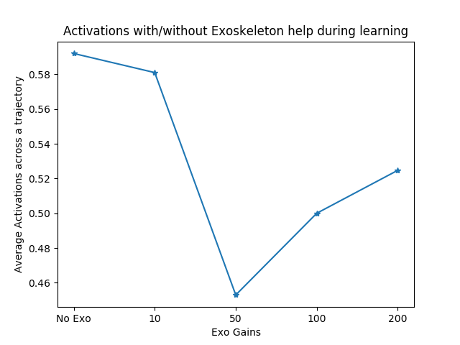
What’s interesting and what’s not ..
Learning Curves
Average Reward
Iterations

Slide 12
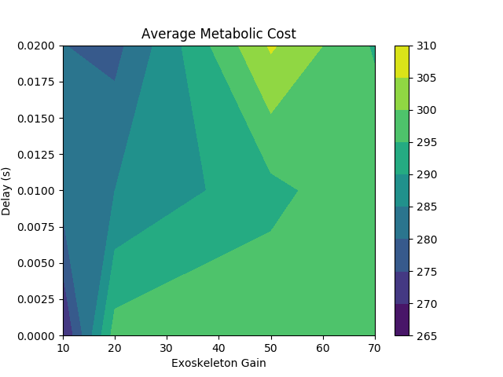
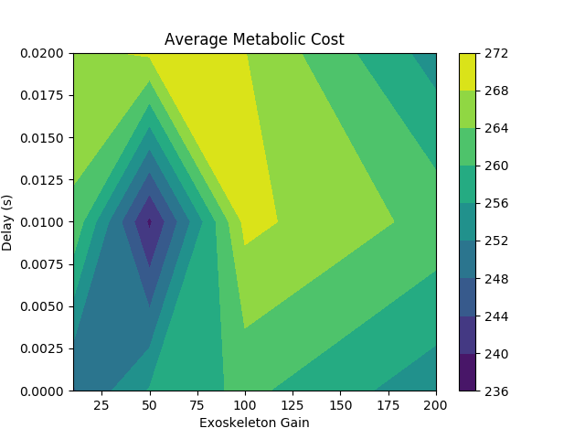
Average metabolic cost :
Elbow Exoskeleton
Shoulder
Exoskeleton
Use Shoulder Exoskeleton!!

Slide 13
Future Directions
Model exo-human interactions
Better exoskeleton controller
Alternative upper limb movements

Slide 14
Backup Slides

Slide 15
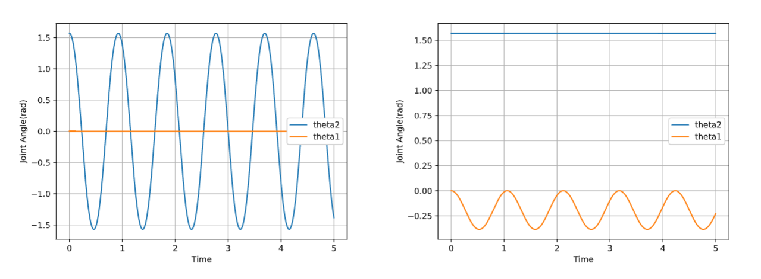
Physics of Two-Linkage System

Slide 16
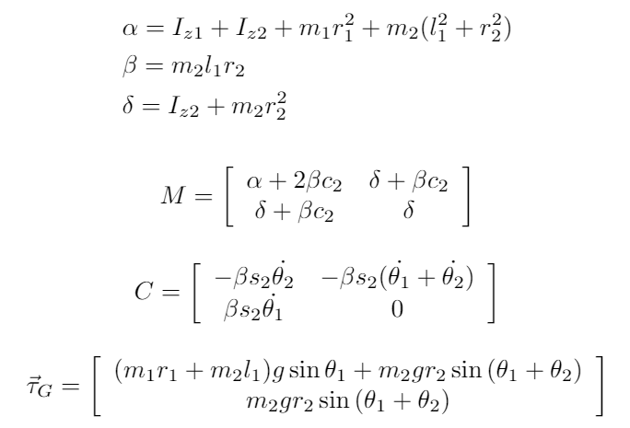

Slide 17
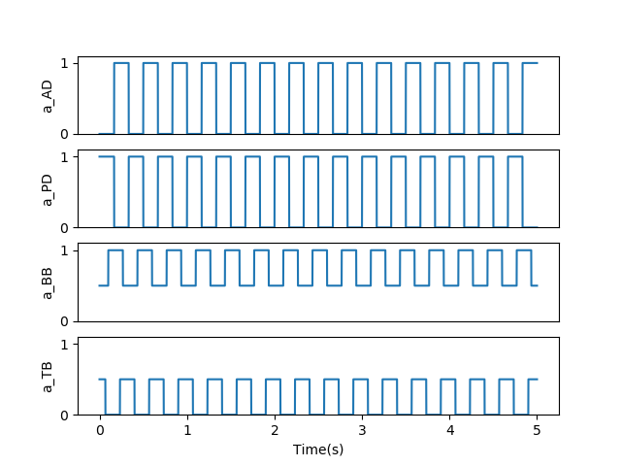
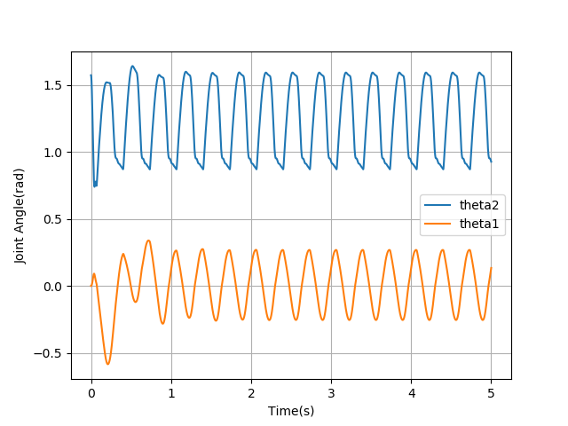
Free Movement Example - Counterclockwise Motion

Slide 18
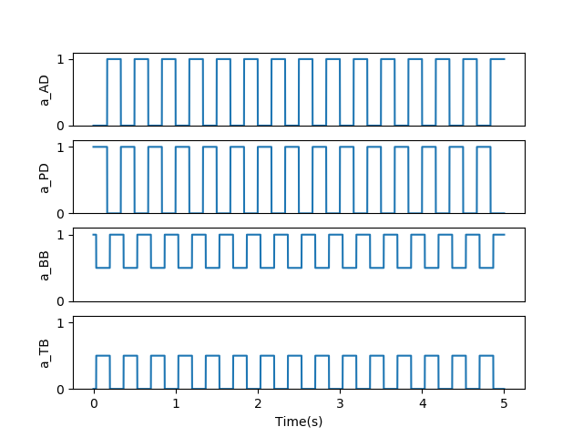
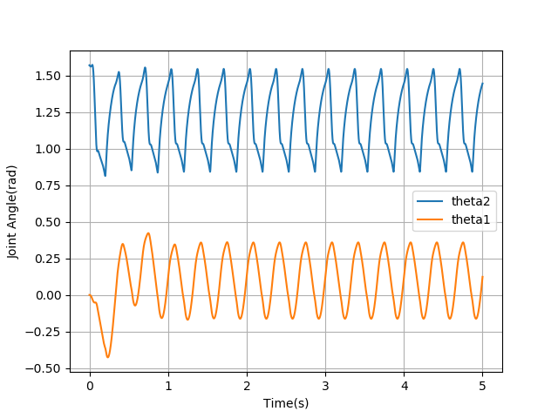
Free Movement Example - Clockwise Motion

